Slide 1

FAKE NEWS CLASSIFIER
Submitted by:
Anchal Awasthi

Slide 2
Table Of Contents
Problem Statement and understanding
EDA steps and Visualization
Conclusion

Slide 3

Problem Statement
The authenticity of Information has become a longstanding issue affecting businesses and society, both for printed and digital media. On social networks, the reach and effects of information spread occur at such a fast pace and so amplified that distorted, inaccurate, or false information acquires a tremendous potential to cause real-world impacts, within minutes, for millions of users. Recently, several public concerns about this problem and some approaches to mitigate the problem were expressed.
So our work is to build a model to detect the Fake news. This project is highly associated with real word. Because in the world we stay, work & move depending on news. And circulation of Fake news can effect a lot to everyone.

Slide 4
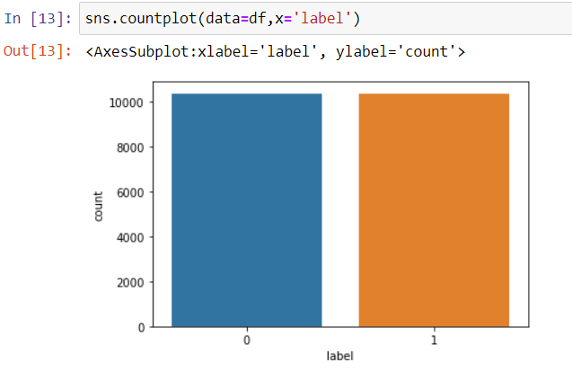
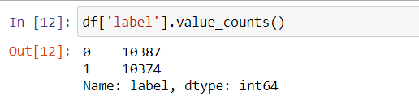
Exploratory Data Analysis
It can be seen that the dataset is well balanced

Slide 5
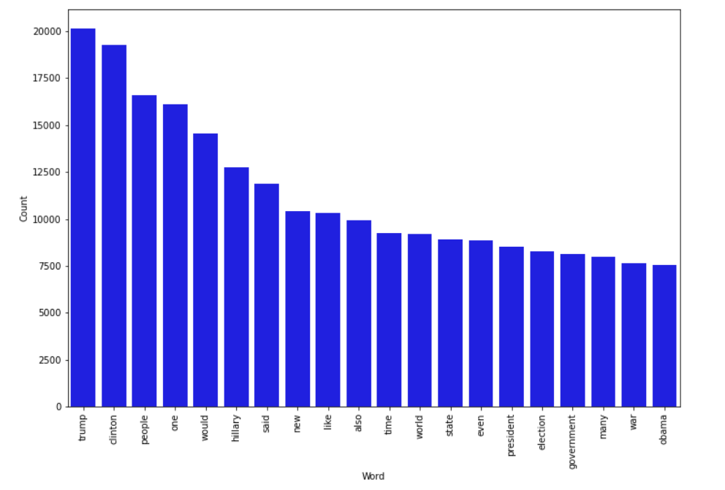
Top 20 most frequently occuring words in fake news

Slide 6
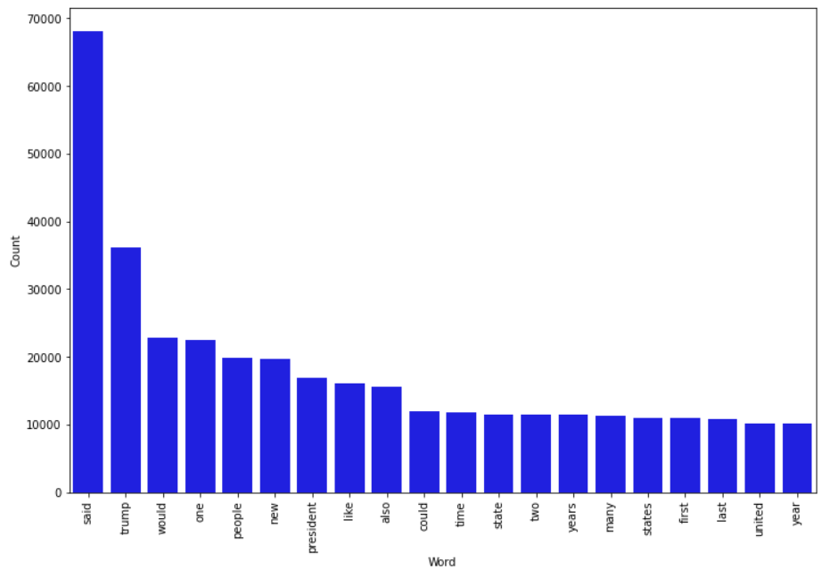
Top 20 most frequently occuring words in genuine news

Slide 7
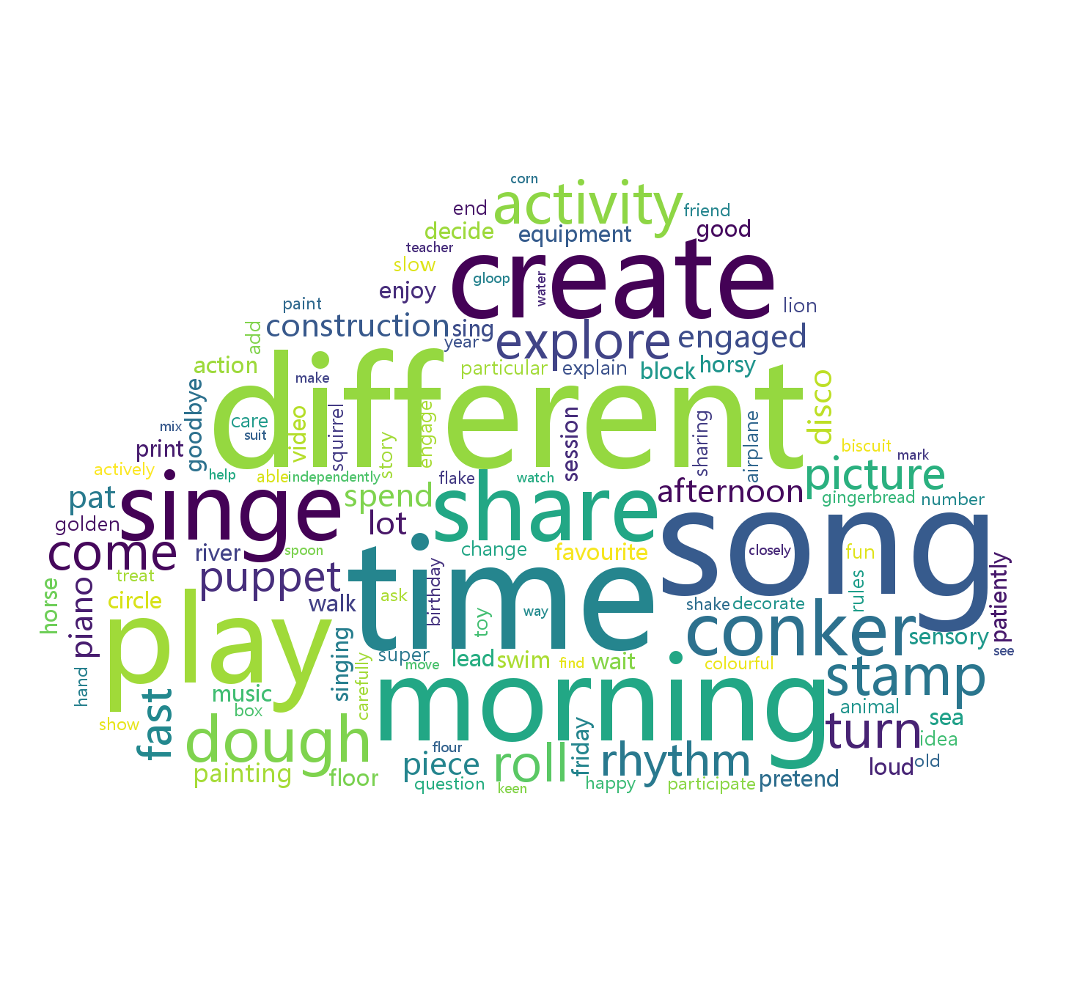
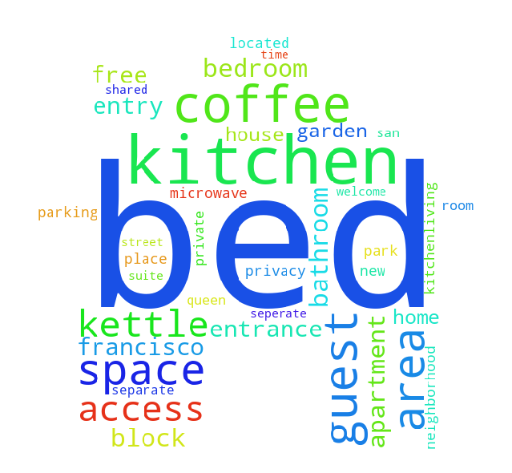

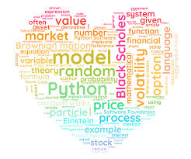
Data Analysis using Word Cloud
Word Cloud is a data visualization technique used for representing text data in which the size of each word indicates its frequency or importance. Significant textual data points can be highlighted using a word cloud. Word clouds are widely used for analyzing data from social network websites

Slide 8
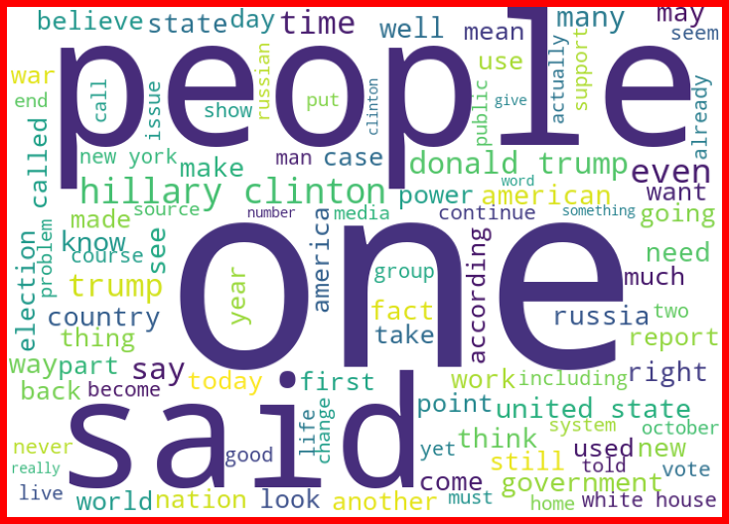
Python WordCloud for fake news

Slide 9
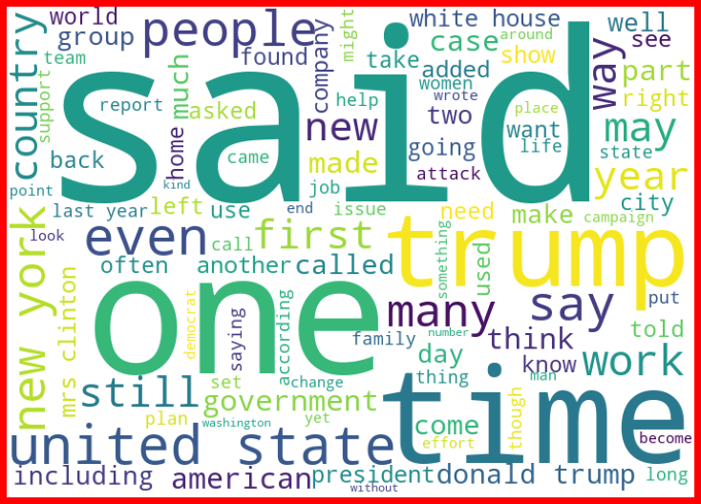
Python WordCloud for genuine news

Slide 10
Conclusion
- The dataset is well balance between fake and genuine news, hence the model will be trained well and will produce accurate results, the model will be able to predict fake news accuratly.
- Most of the fake news revolves around political section. Can be assumed that fake propagandas are aired for their personal gain.
- It is easier to predict fake news using key words, than to predict genuine news as genuine news does not necesarily have any keywords.

